Slide 1

Mentalist
Website https://mentalist.app
Family plans
Gifts to buy
My birthday wishes
Recipe catalog

Slide 2
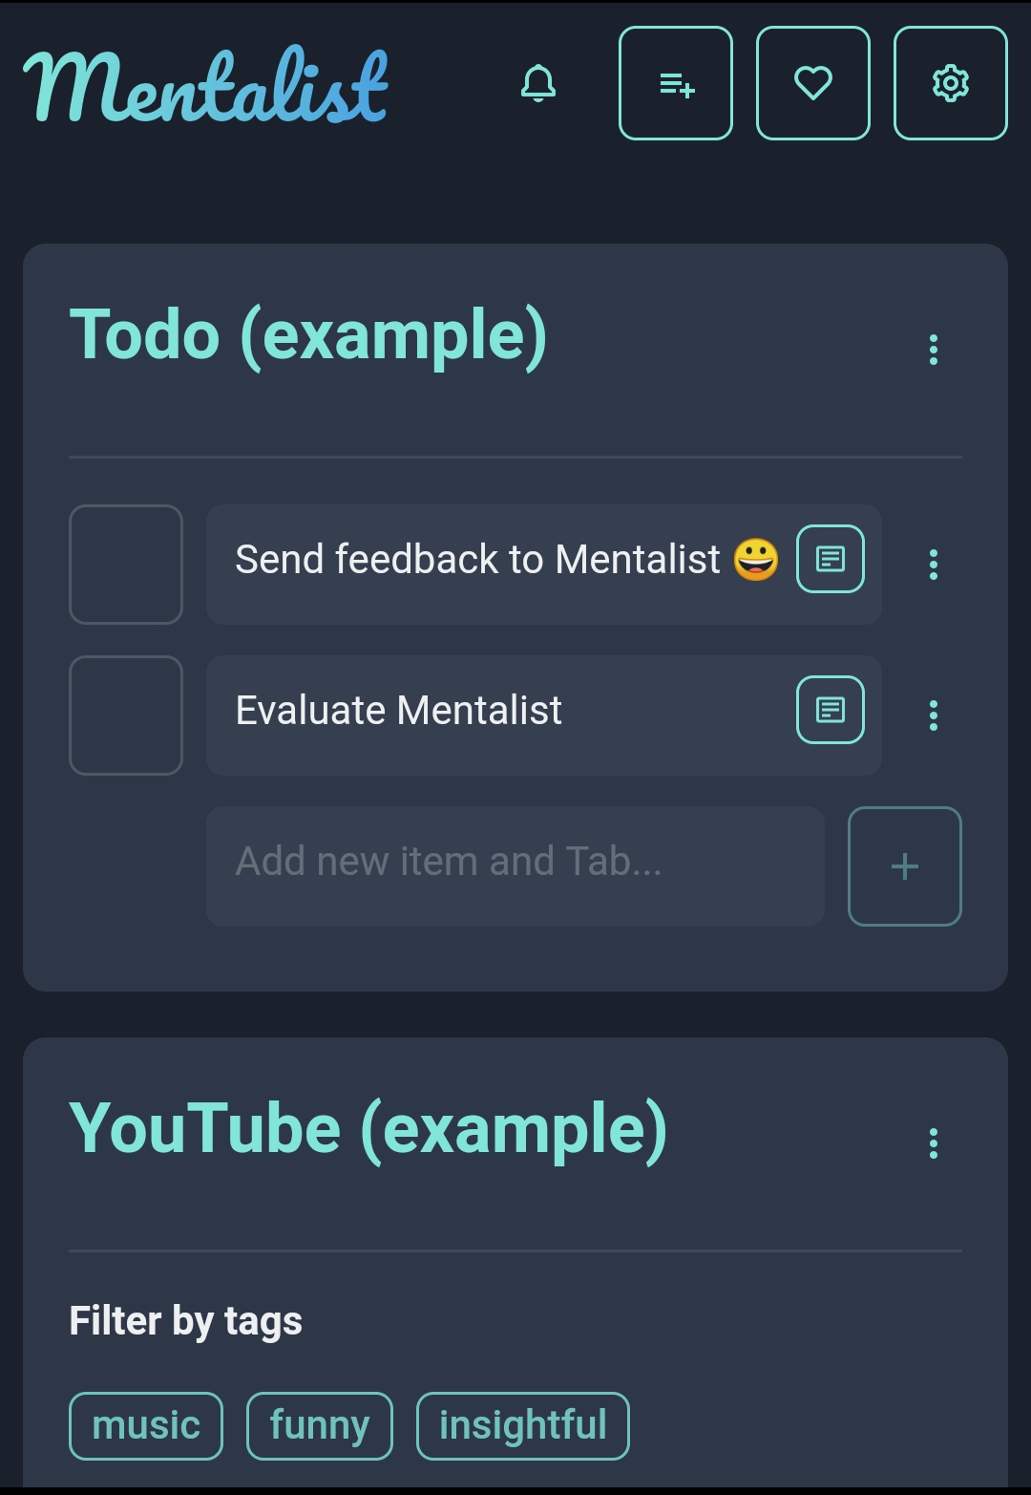
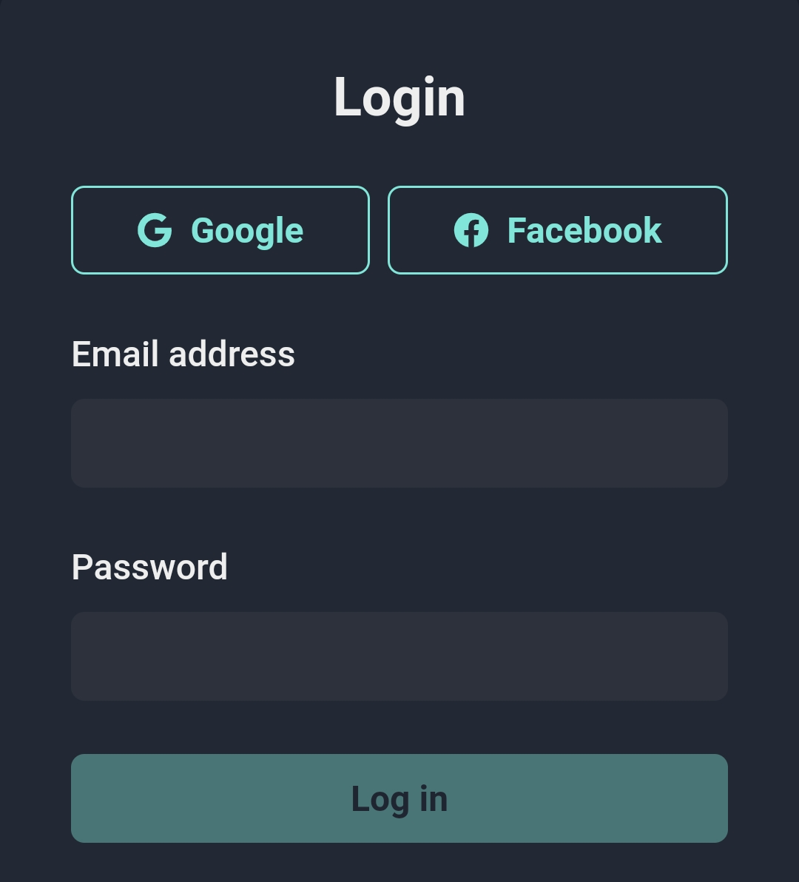
Mentalist
ToolBar
Lists & Items
Login form
Lists menu
Items menu

Slide 3
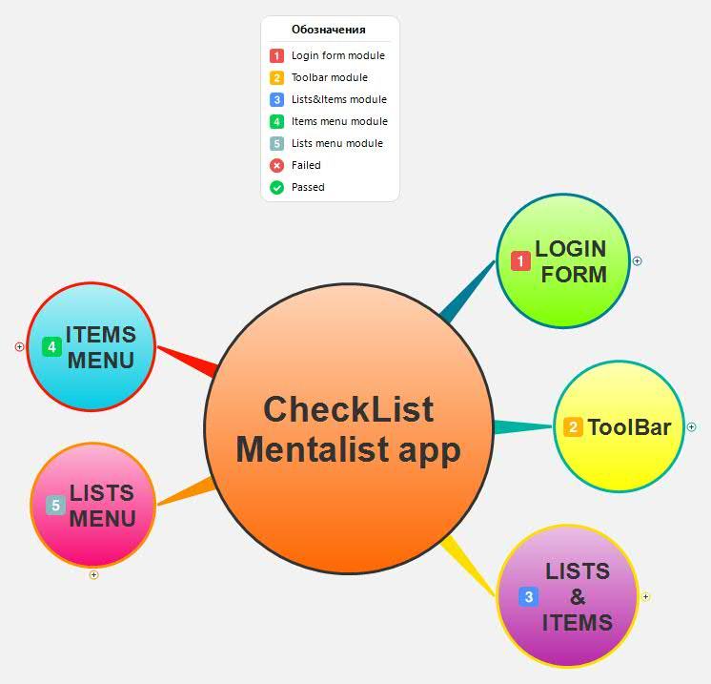
Mentalist

Slide 4
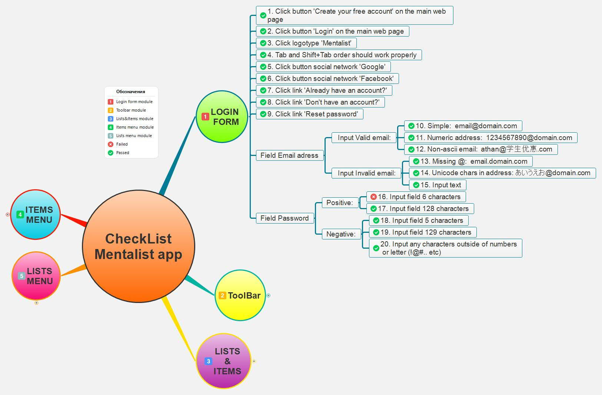
Mentalist Login form

Slide 5
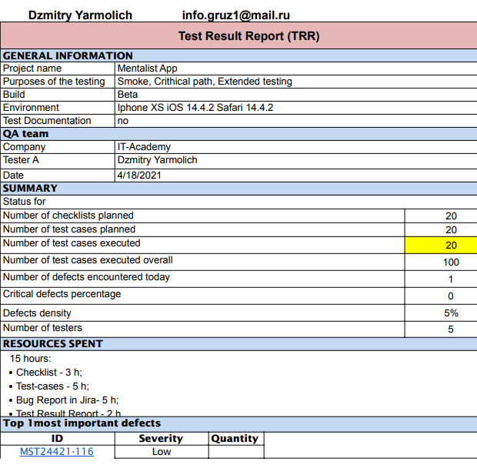
Mentalist Login form and TRR

Slide 6
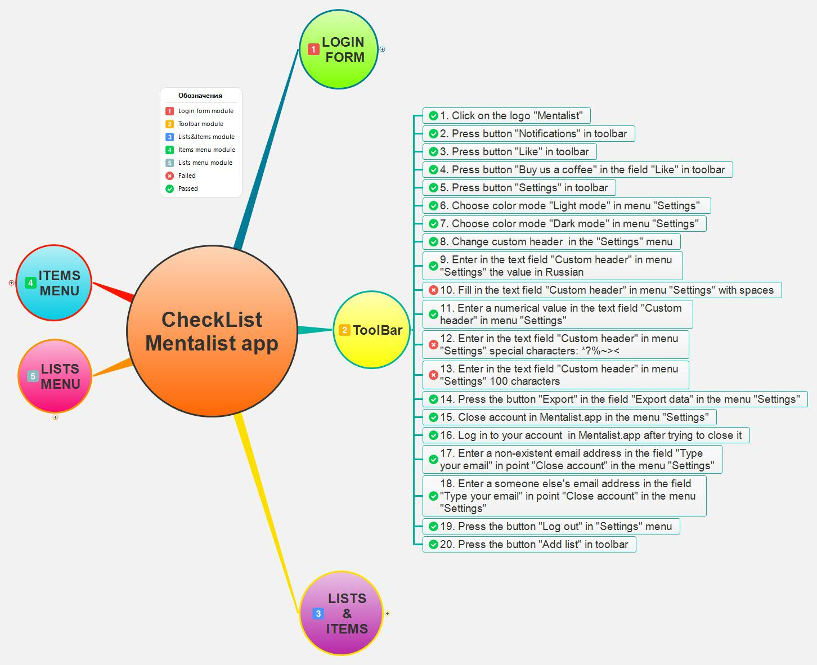
Mentalist ToolBar

Slide 7
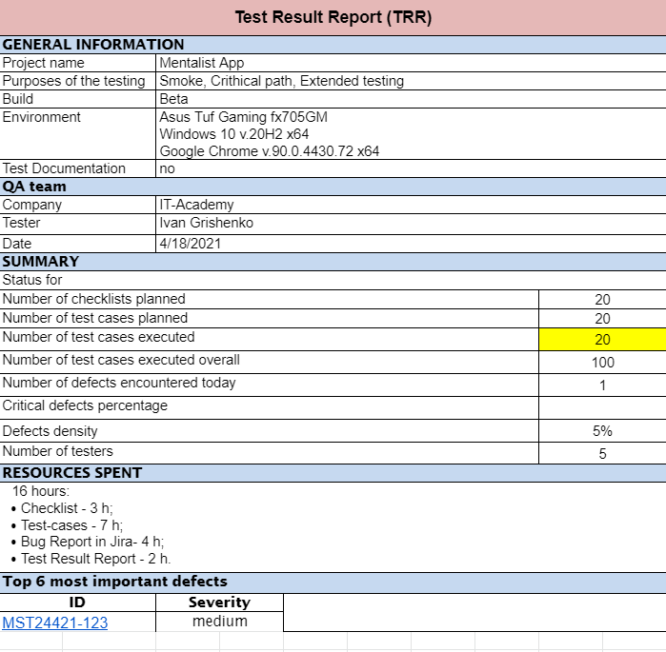
Mentalist ToolBar and TRR

Slide 8
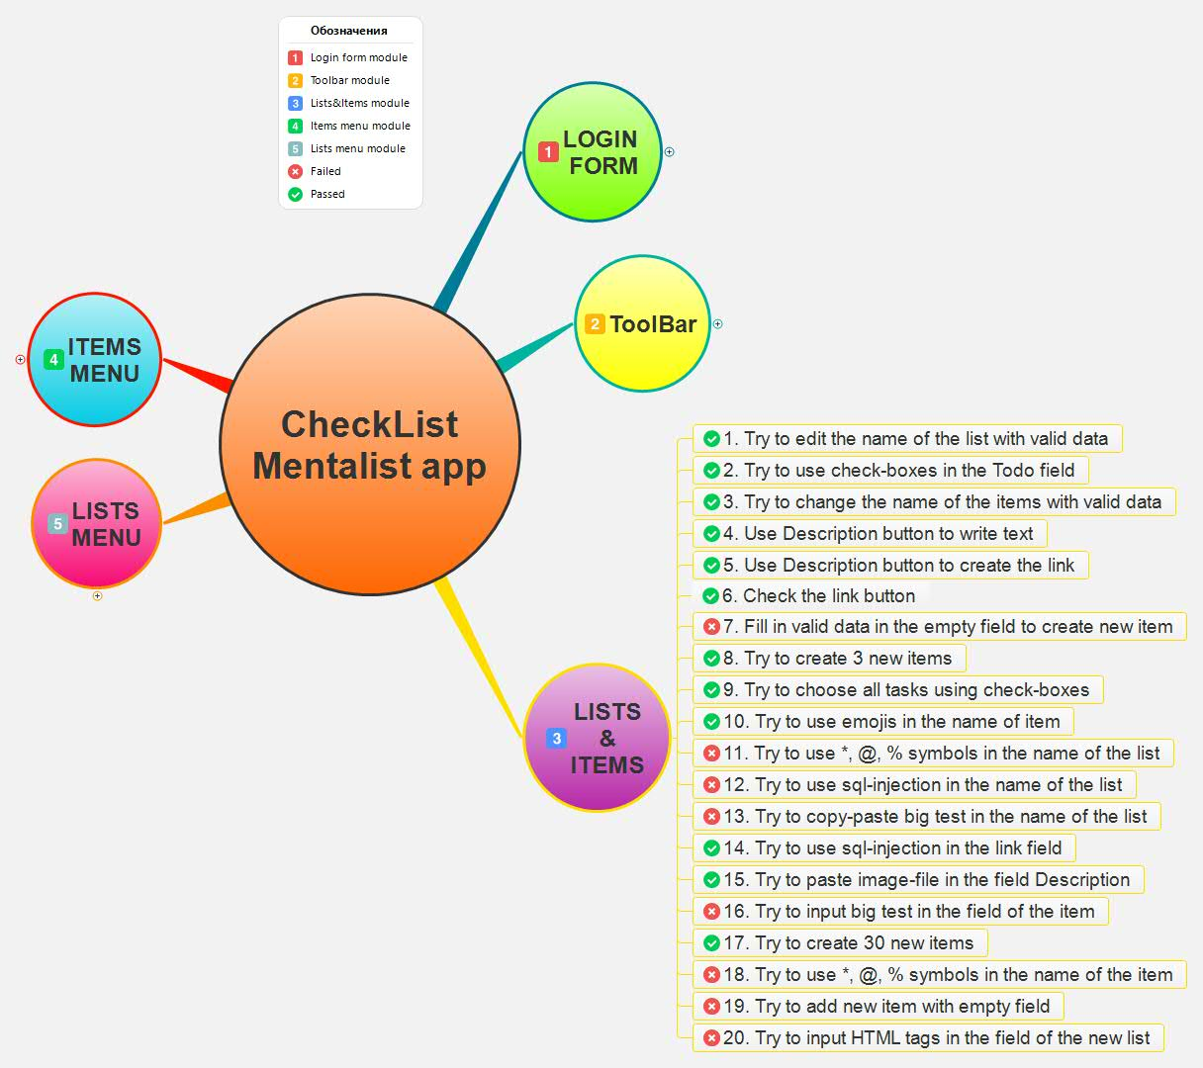
Mentalist Lists & Items

Slide 9
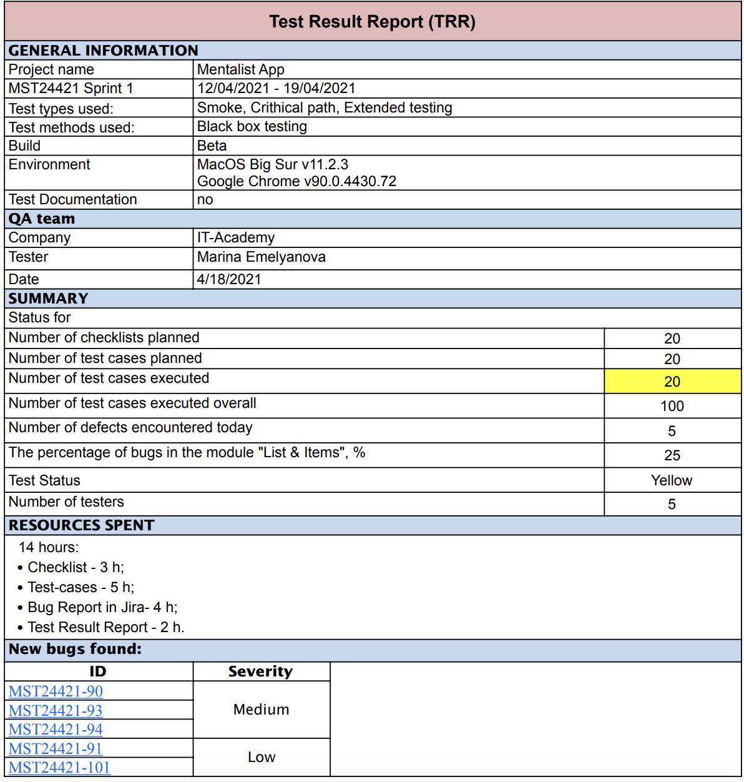
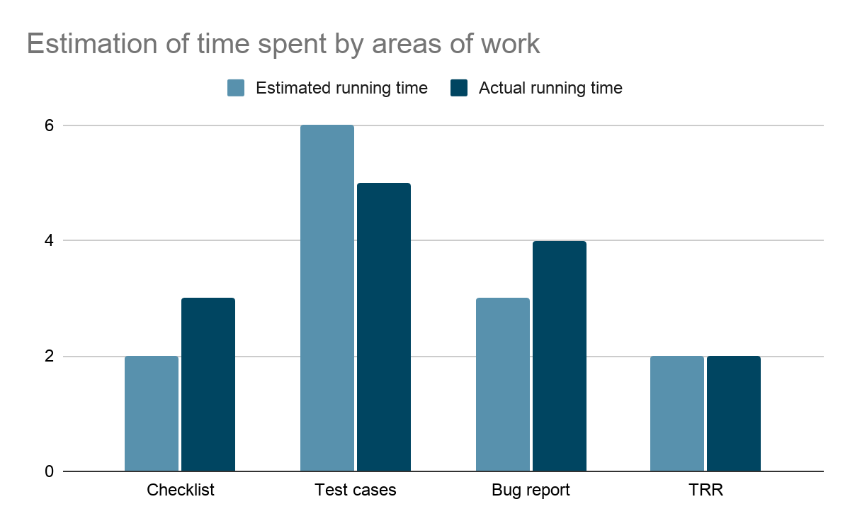
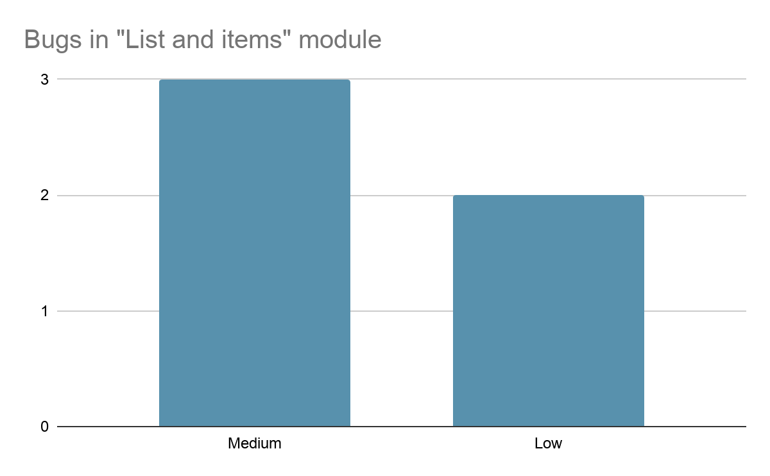
Mentalist Lists & Items TRR
Efficiency of test cases
Number of bugs found
Number of test cases
5/20=0,25
Bugs density
Number of module bugs
Total number of bugs
5/16=0,3
Percentage of test cases with status “Passed” - 60%
Percentage of test cases with status “Failed” - 40%

Slide 10
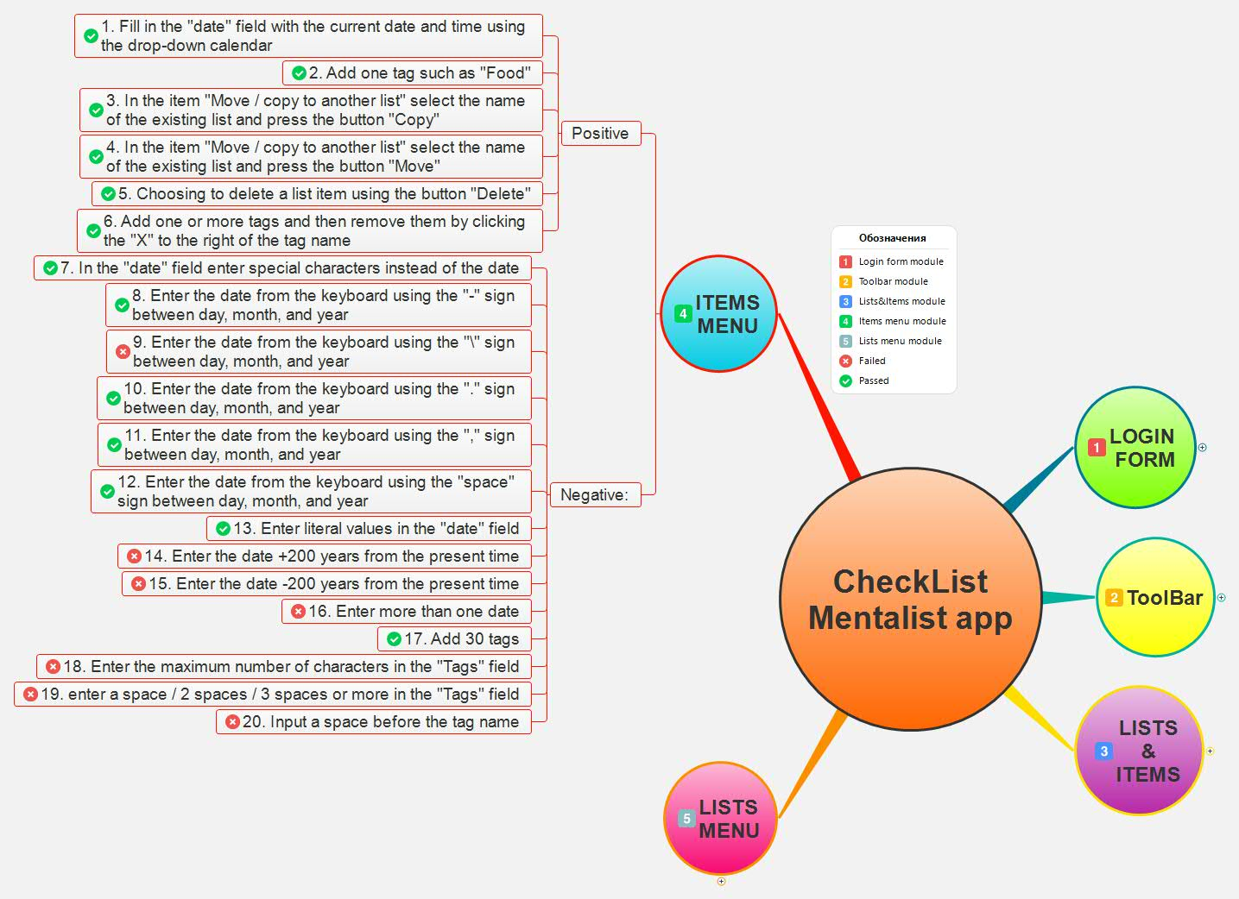
Mentalist Items Menu

Slide 11
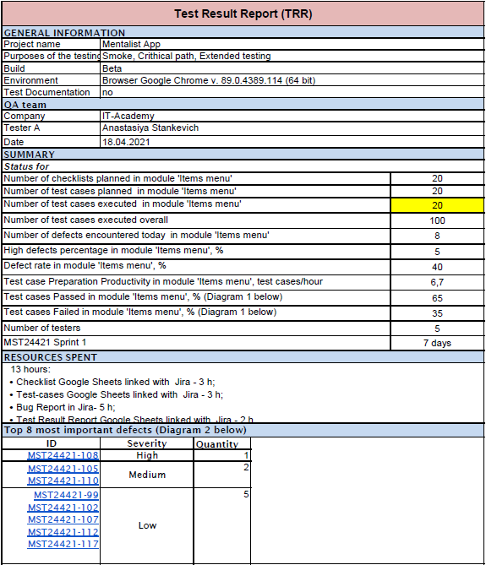
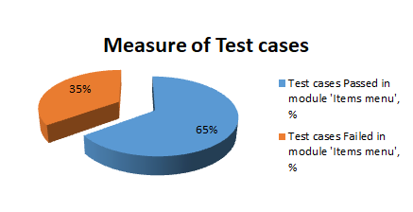
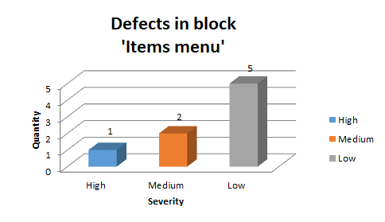
Mentalist Items Menu and TRR
Diagram 1
Diagram 2
Test case Preparation:
№ of Test cases/Effort spent for Test case Preparation=20/3 = 6,7 test cases/hours
Test case Passed in Module:13/20×100% = 65%
Test case Failed in Module: 7/20×100% = 35%
Effectiveness of the Test cases:
Defect Rate=8/20×100%= 40%

Slide 12
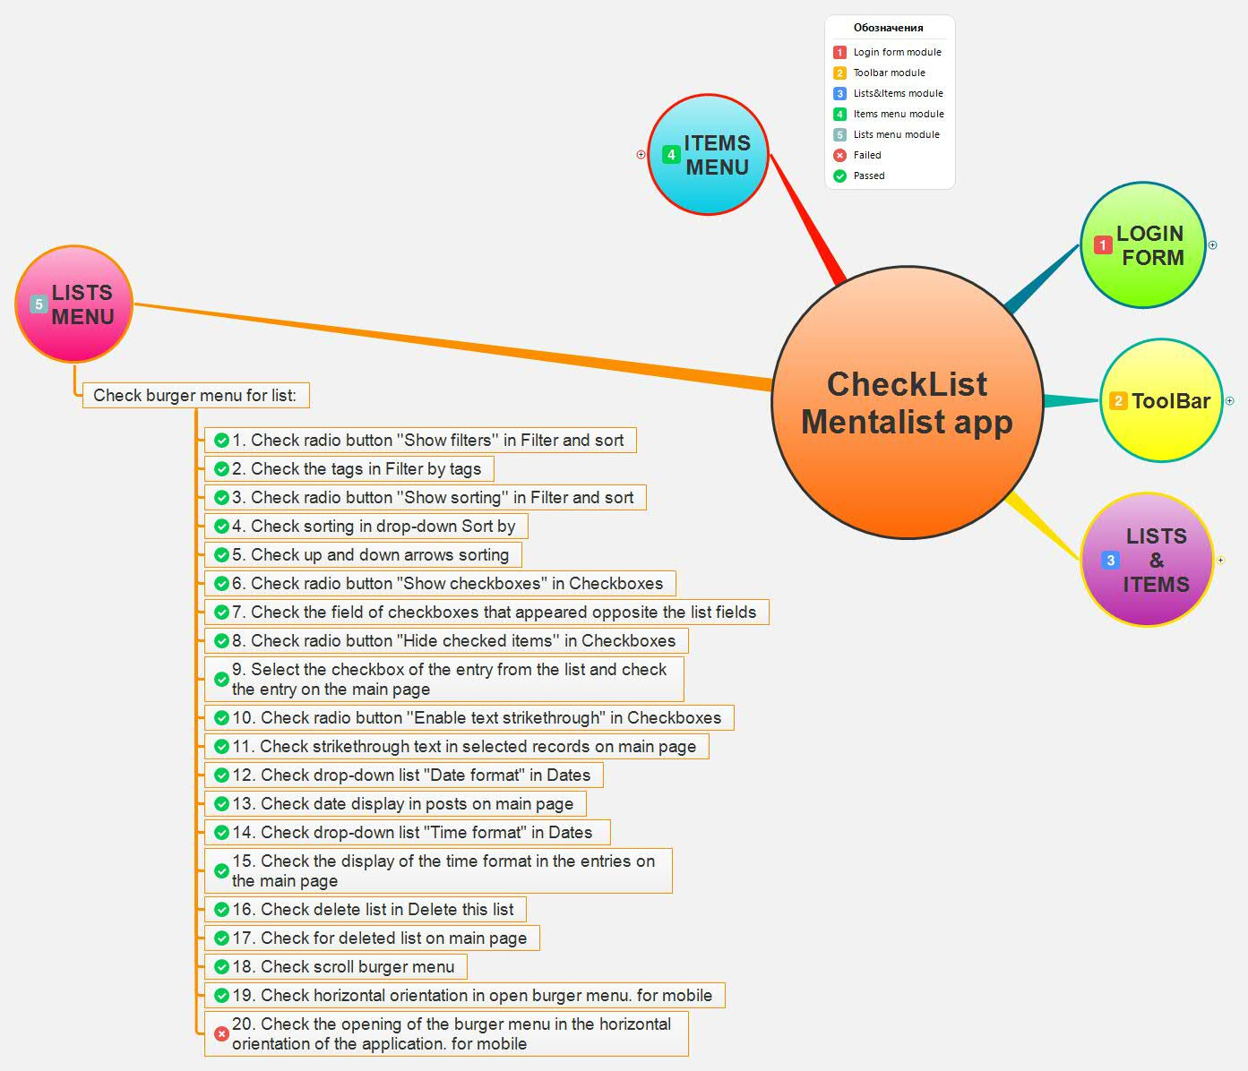
Mentalist Lists Menu

Slide 13
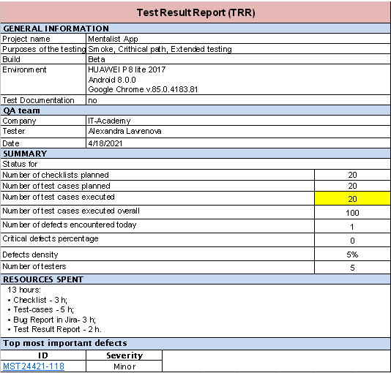
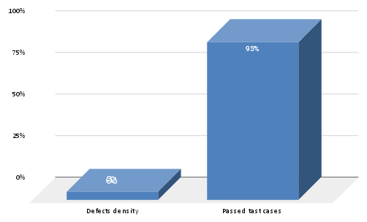
Mentalist Lists Menu and TRR

Slide 14
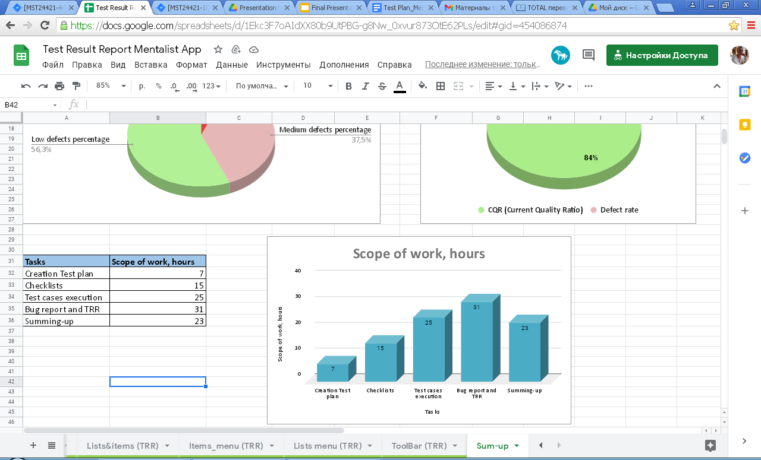
Mentalist
Total results
 | Login_form | ToolBar | Lists & Items | Items_menu | Lists_menu | Total
Number of defects | 1 | 1 | 5 | 8 | 1 | 16
High defects | 0 | 0 | 0 | 1 | 0 | 1
Medium defects | 0 | 1 | 3 | 2 | 0 | 6
Low defects | 1 | 0 | 2 | 5 | 1 | 9
Number of test cases | 20 | 20 | 20 | 20 | 20 | 100

Slide 15
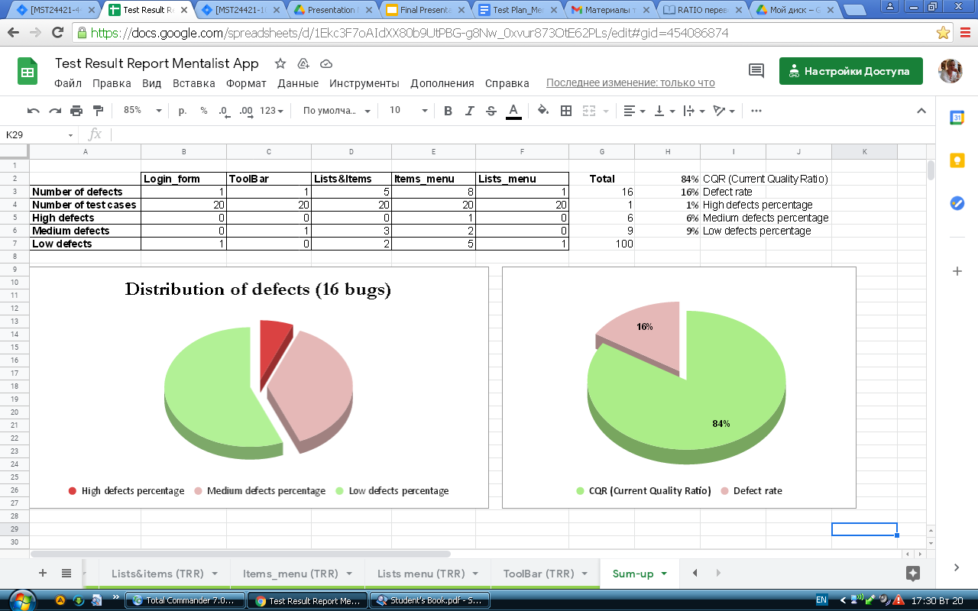
Mentalist
Efficiency of testing

Slide 16

Mentalist

